Slide 1
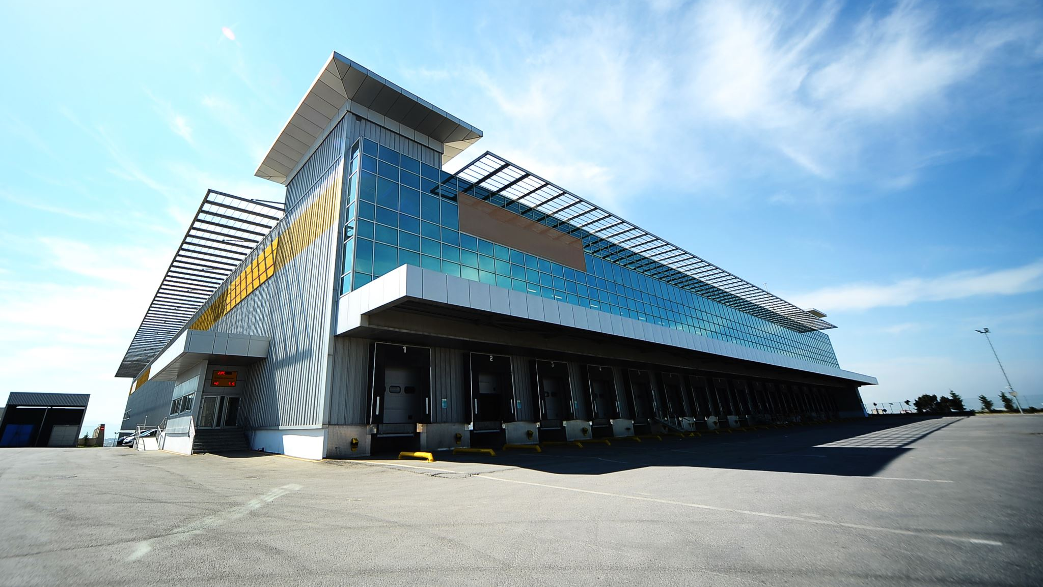
Automated parking management system

Slide 2

About myself
Aswin Prasad
MSSE, San Jose State University
Two years of software development experience.

Slide 3
Related concepts
Internet of Things (IoT).
Popularity of Smartphones.
Notes:
The Internet of Things (IoT) means the network of physical objects that are connected via the Internet. Embedded, network, and software engineering concepts realize the Internet of Things.
From the beginning of the 21st century, due to efficient manufacturing that reduced the costs and increasing interest in smartphone. There are 3 billion smartphones as of December 2020. This increased interest in smartphones has brought so many appealing use cases that can be accomplished using your smartphones.

Slide 4

Introduction
Problem statement
Proposed solution
Notes:
IWe all would have been in a situation in which we would have struggled to find a parking space manually. Especially in locations with big parking space, during rush hours it will be hard to find one.
The latest development on the Internet of Things (IoT) and Smartphones can be used to solve this ever-lasting problem. In this presentation, I am proposing a solution using IoT and a smart phone application that will help the users to park more efficiently and make the process of parking more streamlined.

Slide 5
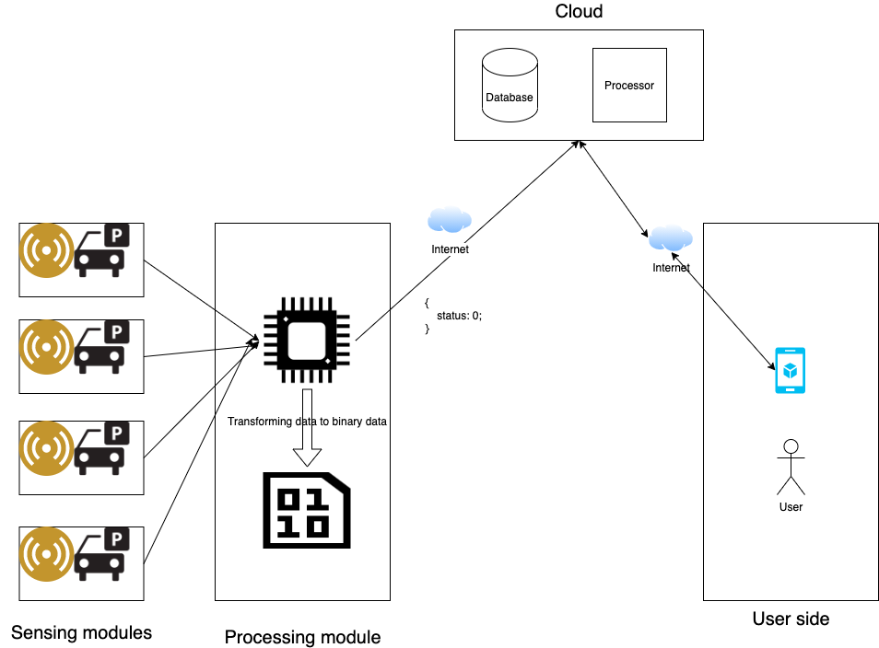
System design
Sensing module
Processing module
Cloud module
User module
Notes:
Sensing module
The sensing module in the architecture is the entry point to the system. Each sensing module will have an Infrared (IR) sensor. This sensor will be able to detect if there is something that is obstructing its field of vision. If there are obstacles it means that there is a vehicle currently parked in that spot.
Processing module
The processing module is responsible for collecting data from all individual sensor modules, summarizing it, and then processing it into meaningful data. This module is also responsible for the management of abnormal conditions, for example, when the sensor module stops running, it can veto the sensor's behavior.
Cloud module
The cloud module is behind the storage of the whole of parking data. In addition to that, cloud computing has advantages such as easy management, cost reduction, uninterrupted services, disaster management, and green computing [3]. No need to store all data locally but put everything in place. Cloud computing can easily solve many potential problems that may occur in the local data infrastructure.
User module
The user module contains a user interface, the user can use the user interface to understand the status of the parking lot. The smartphone application is chosen to be the primary interface for the users. When the user is using the application, the user’s location is retrieved, and the nearby parking lot’s status is shown to the user. The user can then use this information to make a calculated decision of which parking space to take up.

Slide 6
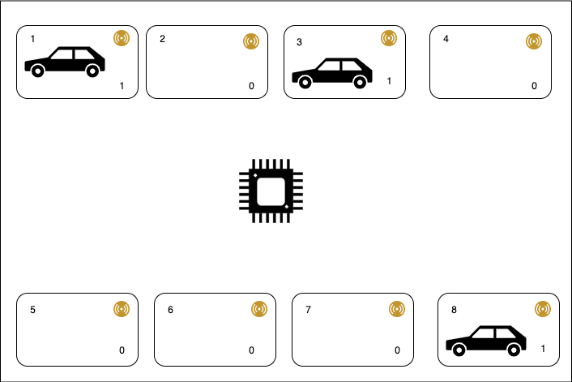
Prototype
Notes:
We tried to build a prototype using the architecture suggested above. The prototype has 8 parking spaces, of which 3 are equipped with cars and 5 are empty. “1” is sent as input from the filled slots and “0” from empty slots.

Slide 7
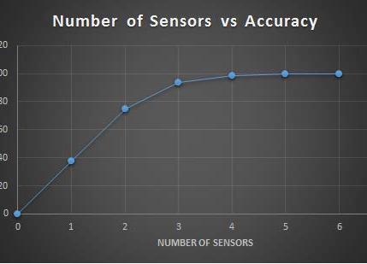
Accuracy
Increasing accuracy
Increasing number of Infrared sensors.
Use along with Ultrasonic sensors.
Notes:
There are some problems like Dust, lack of light, obstruction that can affect the accuracy. These problems can be rectified in two different ways.
The first approach is to simply increase the number of Infrared Sensors (IR) sensors. Because there is more than one source of data for each parking lot, the status of each parking lot is calculated using the combination of more than one IR sensor. This can reduce the chance of errors.
Another way to improve accuracy is to use an ultrasonic (US) sensor that can detect distance. In this way, together with the infrared sensor, when the data output by the infrared sensor conflicts, we can use the data of the US sensor to conclude the state of the parking lot. This way, we can rely on status.

Slide 8

Future work
User side improvements.
System side improvements.
Notes:
The proposed architecture provides essential functions that are required for a parking management system. We have divided improvements into two categories, user side, and system side improvements.
User side improvements
Currently, users don't have instant notification alerts to inform them about the parking lot. Having a real-time notification system will be useful for the users to know about the status of the parking lot, and also alert them about unfortunate events like theft.
Another feature that will improve the quality of service is to enable a booking option, this will give peace of mind for a user who wants to reserve in advance.
System side improvements
When the system collects enough data about patterns of availability thought-out a week demand-based pricing can be applied to parking spots at prime times. This has proven to evenly distribute the congestion and also reduce circling time while searching for parking [4].
If the data proves that the parking garage is full most of the time, it can be used to determine the expansion plan of these parking garages.

Slide 9


Thank you
Notes:
In this presentation, we discussed the issues plaguing the existing parking system. Then, we analyzed how to use the latest developments in the Internet of Things (IoT) and smartphones to build a better parking management system.
Thank you.

